Slide 1
Weekly report: Feedback Controller
Week number: 05
Date: 28/10/2025
Supervisor: Prof. Dr.-Ing. David Schlipf
Group members: Mirza Dincer, Saurabh Pankaj Jha
Presenter: Saurabh Pankaj Jha

Slide 2
List of Contents
Tasks of the Week
Step Responses
Extreme Operational Gust Responses
Conclusion
Saurabh Jha - 770271

Slide 3
Tasks of the Week
Step Responses in a Wind Turbine
Extreme Operational Gust for Pitch Controller
Result and Cost Calculation
Saurabh Jha - 770271

Slide 4
Step Response
Step response is the output of a system when the input changes abruptly
It shows how the system reacts to sudden changes in control input.
Why?
Evaluates system stability, dynamic performance and control responses
Simulation Settings
All DOFs enabled except rotor-teeter, yaw and platform DOFs.
120 second of simulation to see the settling.
Simulation for below rated, rated and above rated wind speeds.
Running only feedback controller, no Lidar-assisted controller.
Saurabh Jha - 770271

Slide 5
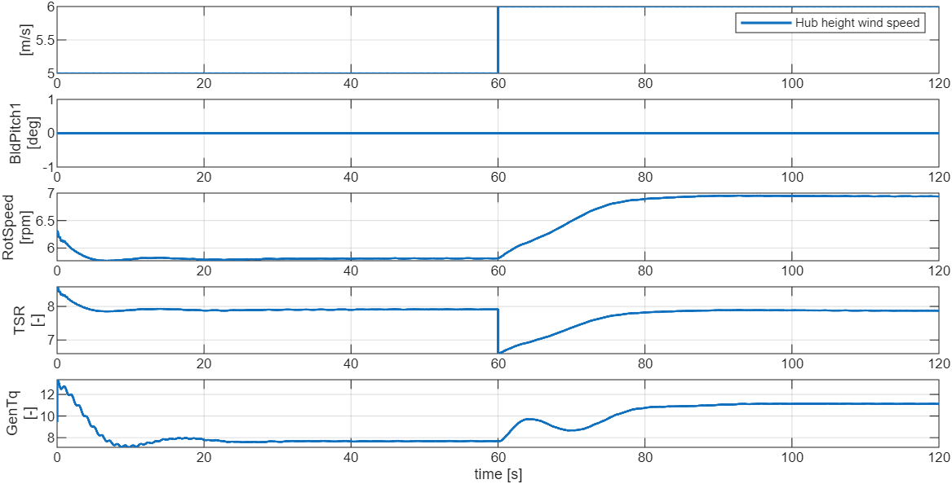
Step response at 5m/s to 6m/s
Saurabh Jha - 770271

Slide 6
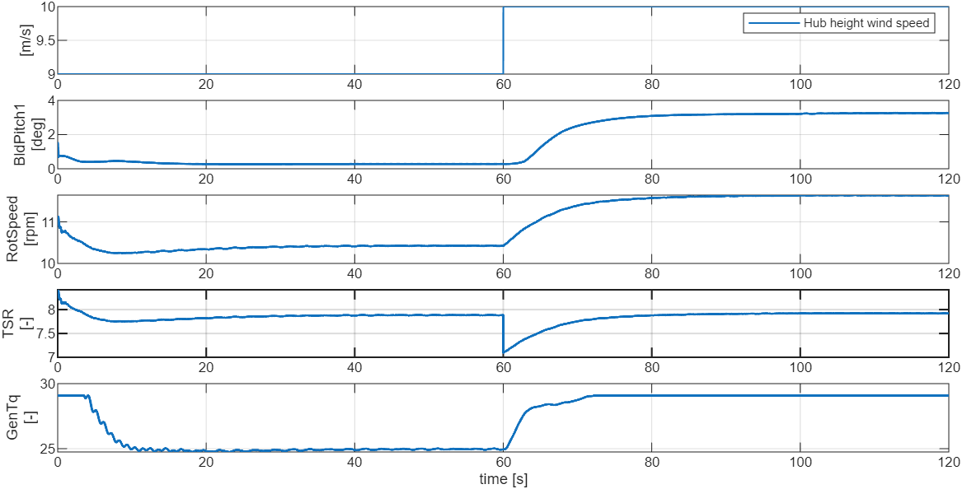
Step response at 9m/s to 10m/s
Saurabh Jha - 770271

Slide 7
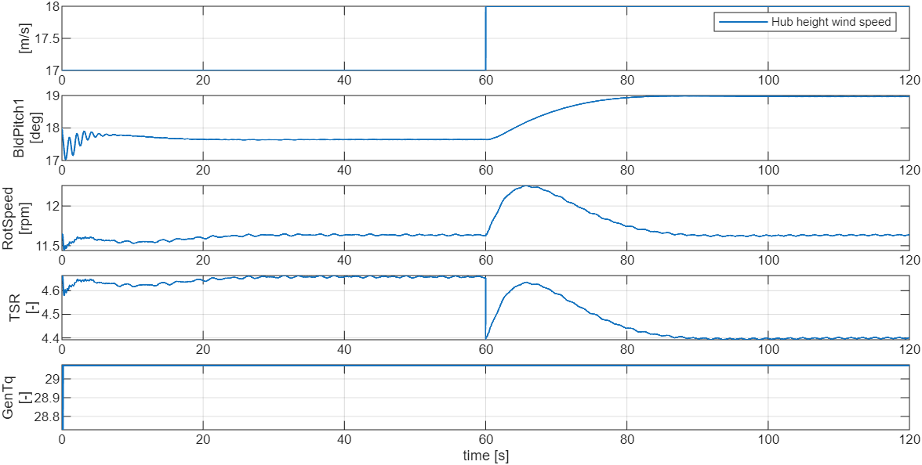
Step response at 17m/s to 18m/s
Saurabh Jha - 770271

Slide 8
Extreme Operating Gust (EOG)
EOG is a rapid and short-lived increase in wind speed, representing a worst-case scenario that wind turbines must be able to withstand safely. (Defined by the IEC 61400-1 )
The pitch controller adjusts the blade angles to manage rotor speed and structural loads during these sudden gusts.
It is important for control performance.
Proper tuning of the pitch controller (Kp, Ki) is crucial for minimizing excessive loads and optimizing turbine lifespan without sacrificing energy production.
Kp (Proportional Gain) : It is how strongly the controller responds proportionally to the present error.
Ki (Integral Gain): It adjusts the controller’s output based on the accumulated error over time, aiming to eliminate steady-state errors
Saurabh Jha - 770271

Slide 9
Simulation Settings for EOG
30 seconds of simulation
EOG wind fields for 12 m/s and 25 m/s, adjusted for IEA 3.4 MW
All DOFs enabled except rotor-teeter, yaw and platform DOFs.
Initial conditions of pitch angle and rotor speed and tower top displacement.
Running only feedback controller with different Kp and Ki, no Lidar-assisted controller.
Saurabh Jha - 770271

Slide 10
Pitch Controller
Saurabh Jha - 770271

Slide 11
EOG @ 12 m/s
Saurabh Jha - 770271

Slide 12
EOG @ 25 m/s
Saurabh Jha - 770271

Slide 13


Results
Cost shows controller performance depending on the rated values. Lower is better.
$${\text{Cost}}_{FB}=\frac{\max\left(\left|RotSpeed\left(t≥t_{\text{Start}}\right)\right|−{\text{RotSpeed}}_{0}\right)}{{\text{RotSpeed}}_{0}}+\frac{\max\left(\left|\text{TwrBsMyt}\left(t≥t_{\text{Start}}\right)\right|−{\text{TwrBsMyt}}_{0}\right)}{{\text{TwrBsMyt}}_{0}}$$
$$A=πr^{2}$$
No change; EOG@12m/s cost = 1.15, EOG@25m/s cost = 1.64
Decrease; EOG@12m/s cost = 1.29, EOG@25m/s cost = 1.81
Increase; EOG@12m/s cost = 1.3, EOG@25m/s cost = 1.86
Saurabh Jha - 770271

Slide 14
Conclusion
Being able to evaluate control response in step responses.
Being able to evaluate control performance in EOG.
Next weeks:
Brute force optimization over DLC 1.2
Saurabh Jha - 770271

